Slide 1
Complex Engineering Workshop
Open Ended Lab Project
Notes:
Be specific and direct in the title. Use the subtitle to give the specific context of the speech.
-The goal should be to capture the audience’s attention which can be done with a quote, a startling statistic, or fact. It is not necessary to include this attention getter on the slide.

Slide 2
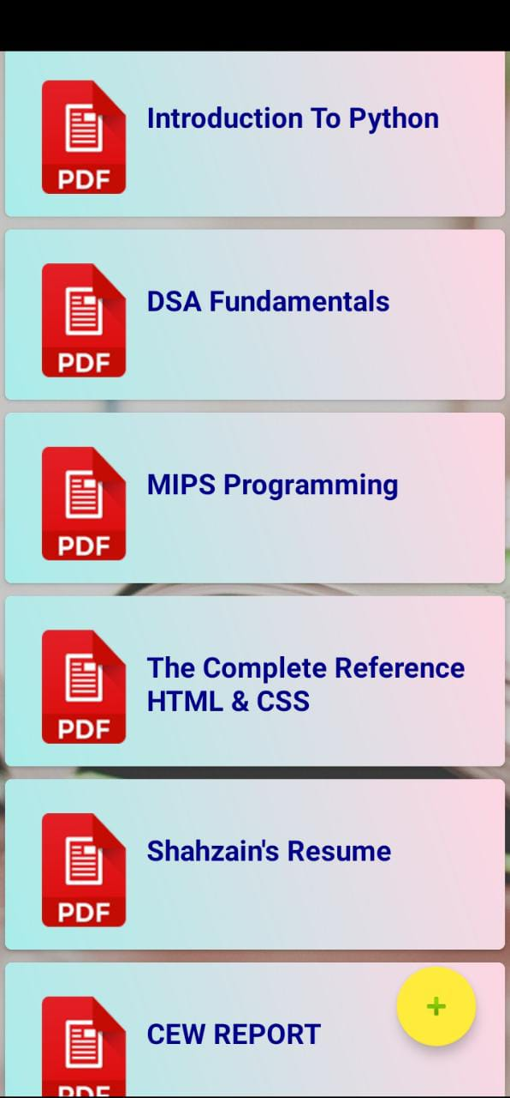

Online Educational App E-Book Reader
WHAT IS AN E-BOOK Reader?
A software application Electronic Book Reader allows to read many books from anywhere in the digital Pdf’s format at your phones.
Snapshots of the Application
Notes:
Use the background points to post details that are not common knowledge, or that the audience will need to understand the context of the speech.
-Do not read these main points from the PowerPoint, instead elaborate on these points during the speech.

Slide 3
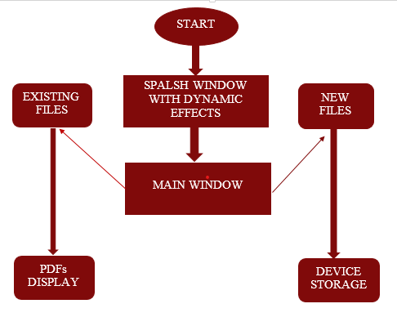
Flow of the application
Splash Screen Display with Dynamic Effects
Main window to show existing Files List
Opens the Selected File in Pdf Format
Option to Add new Files from device storage
Notes:
The title of main point #1 should be clear and concise. Each piece of evidence should be summarized for clarity and cited correctly. Do not simply read the pieces of evidence, but elaborate where needed.
[type notes for elaboration here]
Be sure to transition to main point #2 and the next slide.

Slide 4

Sample Video Showing the E-Book Reader App working
Notes:
The counterargument should be the most common argument against the topic. The goal for this slide is to address the counterargument in such a way as to actually strengthen the original topic. Be sure to address each piece of evidence against the topic. As you address each piece of evidence elaborate on the text found on the slide. Remember to transition to the final slide, the action step.

Slide 5
GROUP MEMBERS
Alina Saghir (CS-21121)
Sadia Moeed (CS-21123)
Syed Shahzain Hassan (CS-21128)
Mohib Ud Udin (CS-21142)

Slide 6
THANK YOU
Notes:
The action step is what the audience is supposed to do or think about the topic. It should be one sentence that is written clearly and with much thought. It may also be the thesis statement restated as an action. The goal of this slide is to leave the audience with a clear message as to what they are to do or think at the end of the speech. It may be a good idea to end with a powerful quote or image.

